Slide 1
AUTOMATION AND CONTROL LABORATORY
Automation and Control Engineering 2015/2016
Control of linear vibrations
Russo Alessio, Savaia Gianluca, Alberto Ficicchia
School of Industrial and Information Engineering
Politecnico di milano
https://github.com/rssalessio/linearVibrationsControl

Slide 2

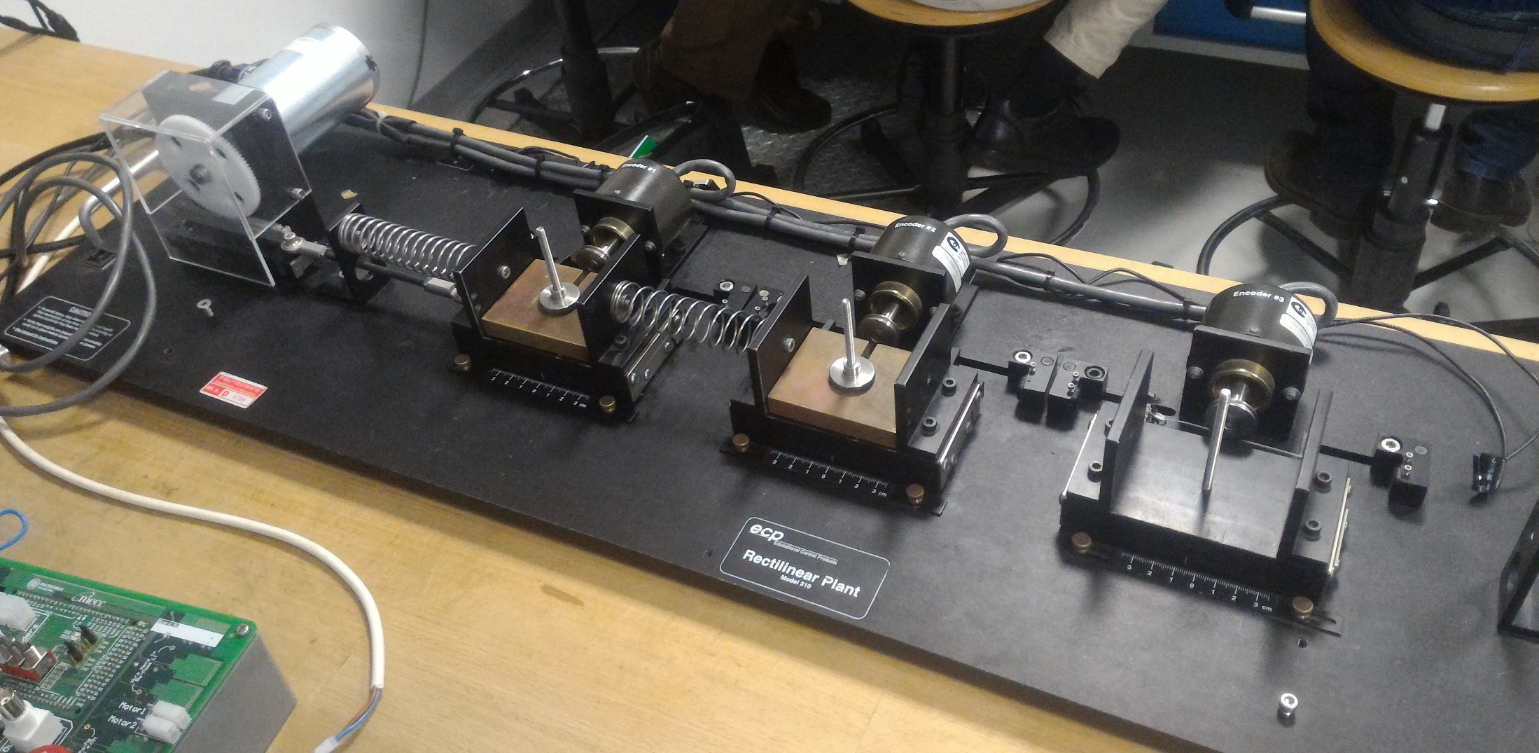
System description
Control of linear vibrations
Brushed motor
Incremental encoder
Cart
Weight
Spring
Arduino board
POLITECNICO DI MILANO
Notes:
Fare due slide e più figure e meno testo

Slide 3
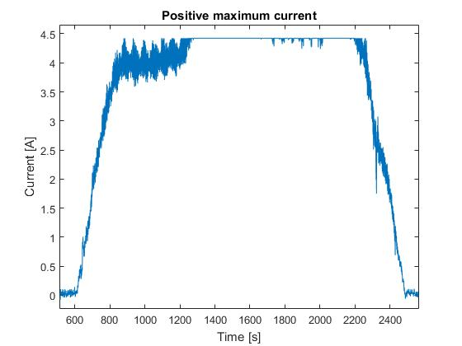
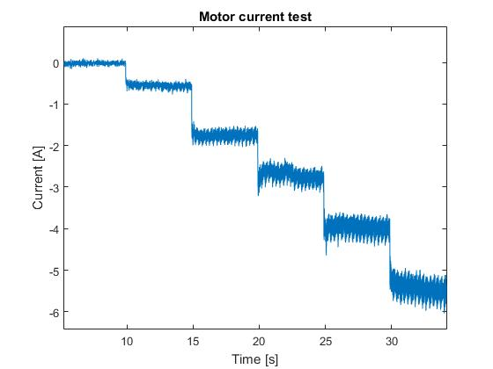
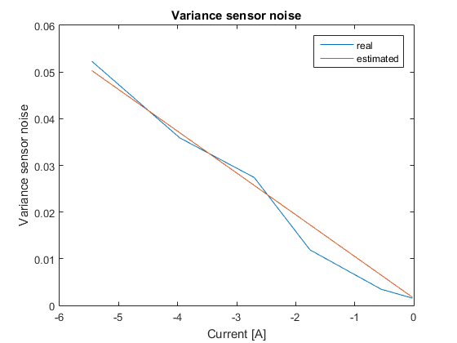
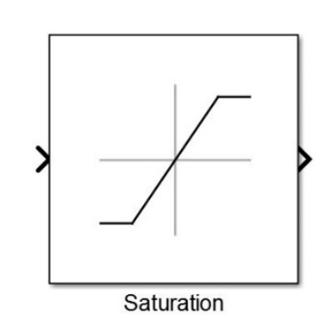
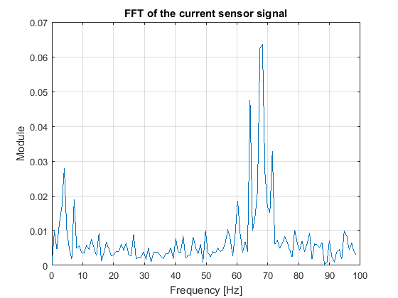
Preliminary issues
Control of linear vibrations
Measurement saturation
Measurement noise
Variable variance
Solved
White noise
Solved
Solved
LS estimation
Fourier transform
POLITECNICO DI MILANO
Notes:
Fare due slide e più figure e meno testo

Slide 4
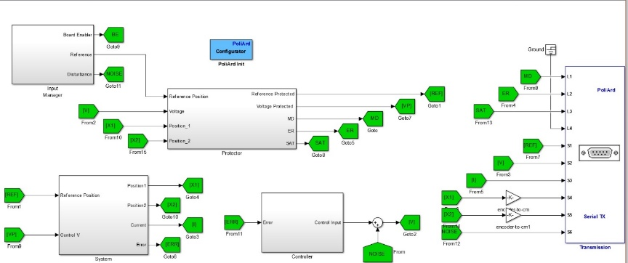
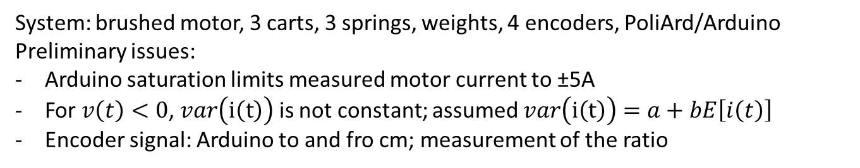
System description
Control of linear vibrations
System: brushed motor, 3 carts, 3 springs, weights, 4 encoders, PoliArd/Arduino
Preliminary issues:
Arduino saturation limits measured motor current to ±5A
For $v\left(t\right)<0$, $var\left(i\left(t\right)\right)$ is not constant; assumed $var\left(i\left(t\right)\right)=a+bE\left[i\left(t\right)\right]$
Encoder signal: Arduino to and fro cm; measurement of the ratio
Protection system - four macroblocks:
Input Manager: selects input, control input noise and reference
Protector: saturates voltage, displacement and reference; synchronizes Arduino and signal starting time; triggers alert
System: motor and encoder feedback
Controller: controls + pulls control voltage to 0 when alert has been triggered
POLITECNICO DI MILANO
Notes:
Fare due slide e più figure e meno testo

Slide 5
Modelling
Control of linear vibrations
Motor: where
: back-emf effect, : torque constant
Pinion/rack: where
: load torque transmitted to the carts
: inertia of motor, pinion and rack
: non linear motor friction
Each cart: where
: total damping (viscous + spring) of the i-th cart
Putting and neglecting nonlinear friction
where
POLITECNICO DI MILANO
Notes:
Mettere foto carrellino
Fare sezioni a scomparsa con immagini riferite al pezzo del modello

Slide 6
1 DOF
Control of linear vibrations
: state of the motor (current)
: position of the cart
: position of the cart
: velocity of the cart
2DOF: Lagrangian approach: where
State space model:
With suitable definitions of M, C, K, B
Analogously for 3 dof
POLITECNICO DI MILANO
Notes:
Levare x1 x2 x3 e fare solo matrici e mettere anche 3 dof

Slide 7
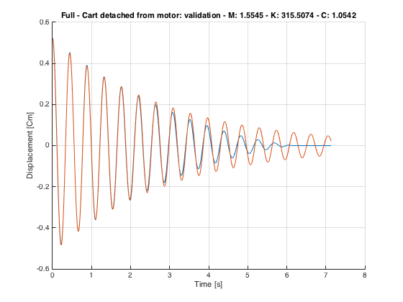
White box identification: detached cart
Control of linear vibrations
The cart was released from a fixed position and allowed to oscillate:
- ; T : time difference between first and second peak
- , ; : amplitudes of first and second peaks
- : for each spring two experiments, with and without load:
- varies with M (ball bearing friction?):
Validation: real output vs simulation (identified parameters):
fit=0.9449±0.0263
Loss of accuracy on the long run
POLITECNICO DI MILANO
Notes:
Inserire freq di campionamento 200 Hz e perché
Inserire schema su come si è fatta l’identificazione: Raccolta dati->elaborazione->creazione modello->validazione (sul sitema reale)
Fare foto grande e spiragre ogni parametro sulla foto
Spezzare in due slides con omega e csi sulla figura e poi altra slide dove si ricavano K,M,C e il fit

Slide 8
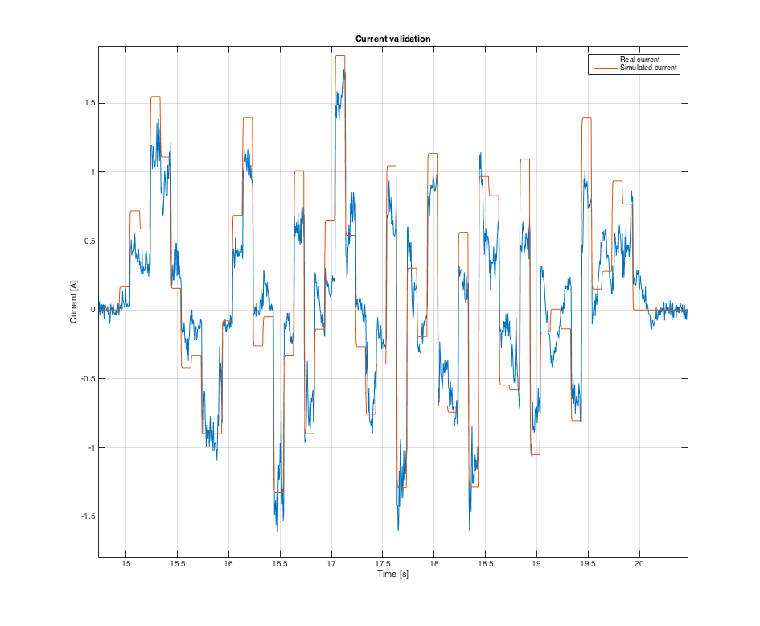
White box identification: motor only
Control of linear vibrations
Resistance only: voltage pulses to motor: steady state measurement of
Resistance and inductance: experimental input/output data given to Matlab tfest (first order)
; back-emf neglected because
,
Nominal values from motor datasheet
,
Validation: real output vs simulation with input = N(0,9/4): fit=0.8142±0.0364
POLITECNICO DI MILANO
Notes:
Voltaggio a onda quadra con corrente che lo segue e fare vedere che la disatnza a steady state è R. L’abbiamo idnetificata cosi.
Per la fuznione di straferimento mettere il blocchetto di simulink nei modelli

Slide 9
Overall system identification
Control of linear vibrations
Same tests and same techniques used for detached parts. Results:
System mass: ; Motor mass:
System springs: , ,
System damping(load/no load):
, ,
, ,
Linear torque constant:
Validation: real output vs simulation with input: where :
Fit:
1 dof: (85.42±1.68)%
2 dof (2 combinations: K_{h}-K_{m}, K_{l}-K_{h}): (86.54±4.68)%
POLITECNICO DI MILANO
Notes:
Levare i valori e mettere solo imamgini e fare vedere con due blocchi simulink che è l’unione

Slide 10
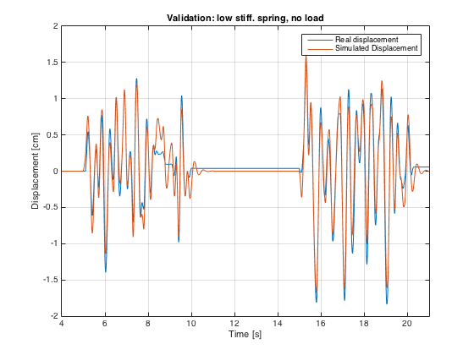
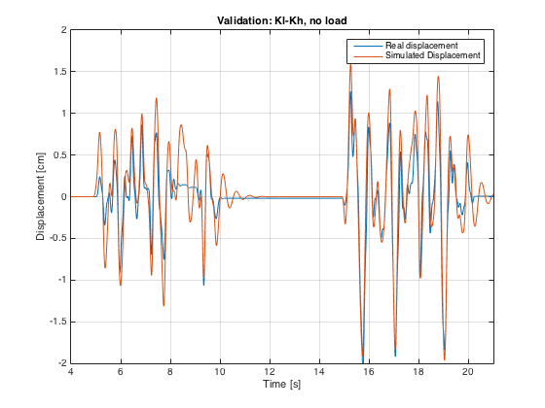
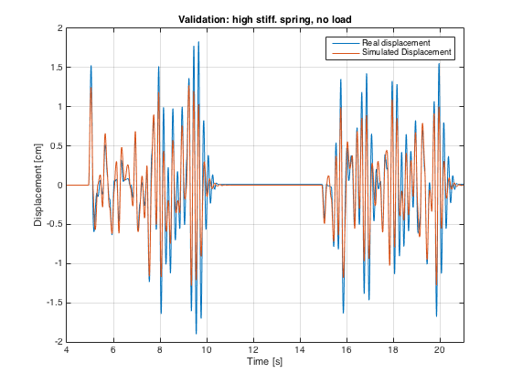
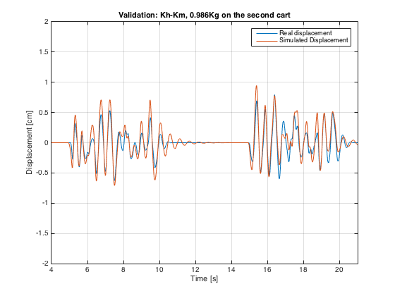
Overall system identification
Control of linear vibrations
1 dof K_{l}
2 dof K_{l} K_{h}
1 dof K_{h}
2 dof K_{h} K_{m}
POLITECNICO DI MILANO
Notes:
Fare anche la gray box

